Slide 1
SBC-AutoOps
Design Partner Briefing
The independent truth layer for real-time voice. We read your SBC configs before deploy and tell you exactly what will break. Your configs never leave your environment.
METAVENTIONS AI
Dico Angelo and Philip Drammeh, co-founders
sbcvalidator.metaventionsai.com | June 2026 | v0.16.4

Slide 2

Calls fail silently. You find out from users.
Every business call crosses a Session Border Controller. One misconfiguration: one-way audio, dead trunks, one to four-plus days of repair. Engineers call the discovery mechanism the scream test. Three named incidents from the 2026 Microsoft CA migration (MC1235747):
Voipcloud
CallTower
FusionConnect
P1 across thousands of users. Untrusted root presented at the mutual-TLS handshake; Microsoft stopped accepting calls.
Silent blackhole. Unpatched SBCs stopped OPTIONS pings; Microsoft auto-deactivated the domain. No SIP 503 warned anyone.
One-way audio on an SRTP mismatch. Honest caveat: this one originated on Microsoft's media-relay side; a config check would not have caught it.
You cannot monitor a call that is cryptographically blocked from ever starting. The check has to happen before deploy.

Slide 3


Slide 4

The cadence, not the climax
June 2026: the serverAuth-EKU enforcement for Teams Direct Routing lands this month. Behind it, per CA/Browser Forum SC-081v3, public TLS certificate lifetimes compress on a fixed schedule:
398
200
100
47
days today
Mar 2026
Mar 2027
Mar 2029
Max certificate lifetime, in days. By 2029 that is roughly eight renewals a year, per SBC, across every vendor you run. Manual validation stops scaling well before 47 days. Each new wave ships as a signed rule bundle on the same engine.

Slide 5
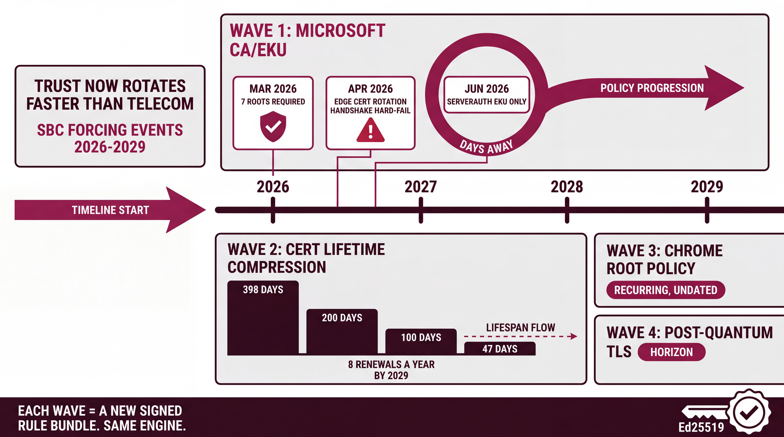

Slide 6

Five vendors. One model. A deterministic verdict.
AudioCodes, Cisco CUBE, Ribbon, Oracle Acme, and Metaswitch Perimeta configs are normalized to one vendor-neutral model and validated across eight domains. Same engine, by construction. Where a format cannot prove a fact, the engine stays silent and says verify out-of-band. It refuses to guess.
5
8
172
1
vendor parsers
validation domains
tests in CI
runtime dependency
Every config gets one of three verdicts, and the same audit artifact from every run path: results/<sbc>/<timestamp>.json, stamped with the ruleset it ran against.
PASS
REVIEW
BLOCK
validate · simulate · explain · diff · fleet · serve · report · probe · demo

Slide 7
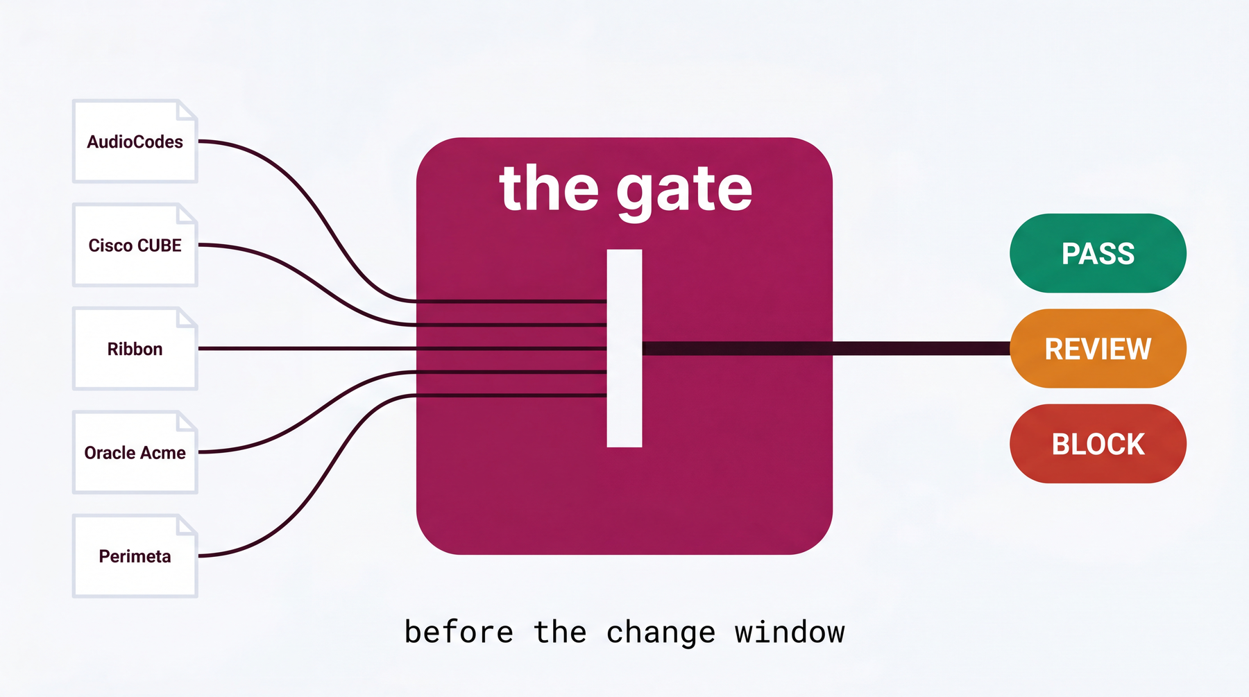

Slide 8

Eight validation domains
A
Syntax / semantic
B
Interop
Malformed config, dangling references
TLS transport, OPTIONS keep-alive, normalization
C
TLS / CA (the 2026 wedge)
D
NAT / media
Missing Microsoft roots, mTLS, SRTP, EKU, chain validity
Private IP in SDP, missing symmetric RTP: one-way audio
E
Codec
F
Topology leak
Cross-leg overlap, forced transcode, DTMF
Private-IP leakage on the signaling plane
G
Routing / classification
S
Security
404 and unclassified Teams routing
ACL default-deny, broad CIDR, rule shadowing
Domain C is grounded against Microsoft Learn: the seven roots, the TLS floor, the cipher allowlist, and the SRTP suite reconciled as exact matches.

Slide 9
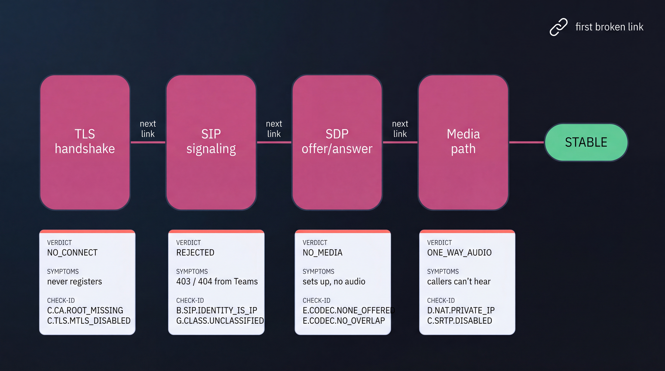

Slide 10

Where does your data go? Nowhere.
INBOUND
One channel: a signed rule bundle. Nothing else. Ed25519-signed, verified before use against a key pinned in source. Freshness floor refuses rollback. 8 MB cap. Configs never travel this channel.
OUTBOUND, default
Nothing. No telemetry, no call-home, no update check. Documented production mode: docker run with network none.
OUTBOUND, opt-in
Anonymized findings, only behind an explicit flag. Check IDs, severities, vendor family, ruleset version, salted org token. Never config text, FQDNs, CN/SAN, IPs, or paths. The exclusion is a 32-line module your reviewer can read live.
RUNTIME
Air-gapped and unprivileged. Non-root (uid 10001). Never touches the SBC: reads config exports only. No CLI sessions, no SNMP, no probes.

Slide 11
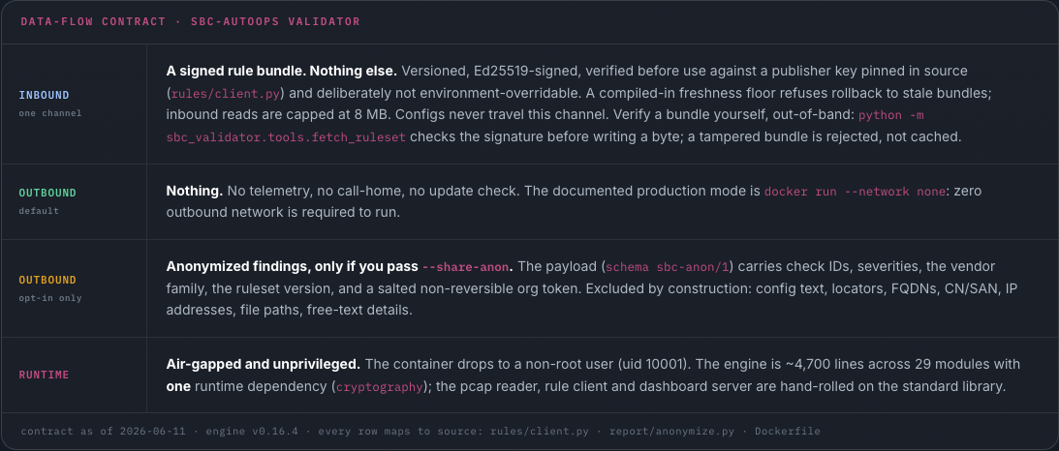

Slide 12
Drive it from an agent
The same air-gapped engine, now exposed to an AI agent through the SBC Inspector MCP - a zero-dependency JSON-RPC-over-stdio server. Same deterministic verdicts, same air gap, now agent-native.
11
3
3
0
tools
prompts
resources
new dependencies
validate · simulate · explain · diff · fleet · report · remediate · inspect-cert · fleet-report · anonymize · probe
Every tool read-only and deterministic · offline by default (probe gated) · typed structured output · MCP 2025-06-18, conformance checked in CI against the official reference inspector.

Slide 13
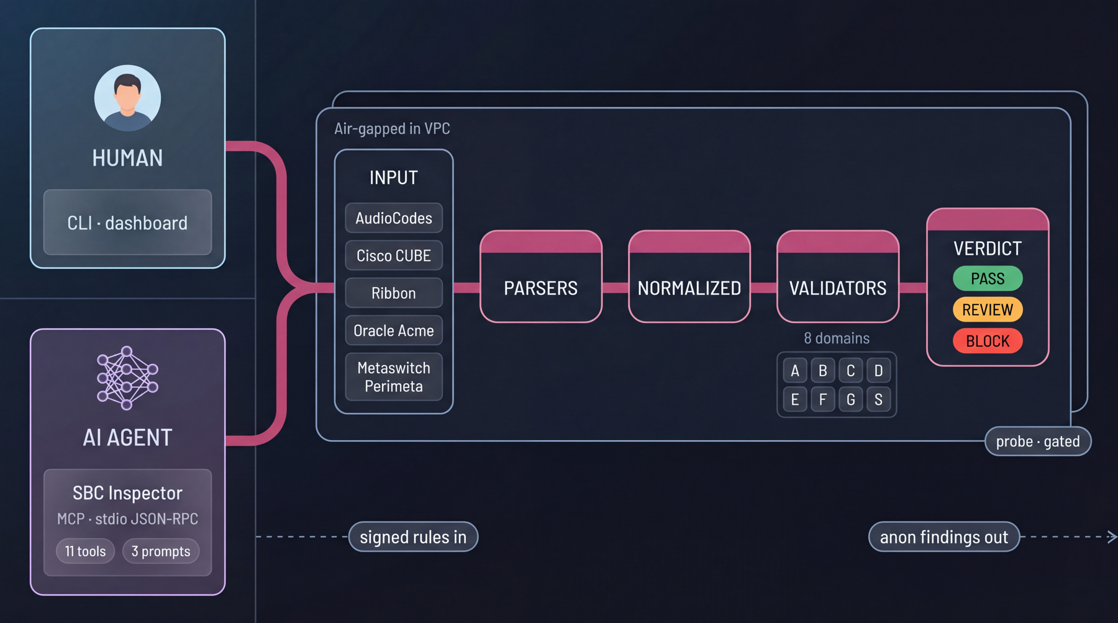

Slide 14
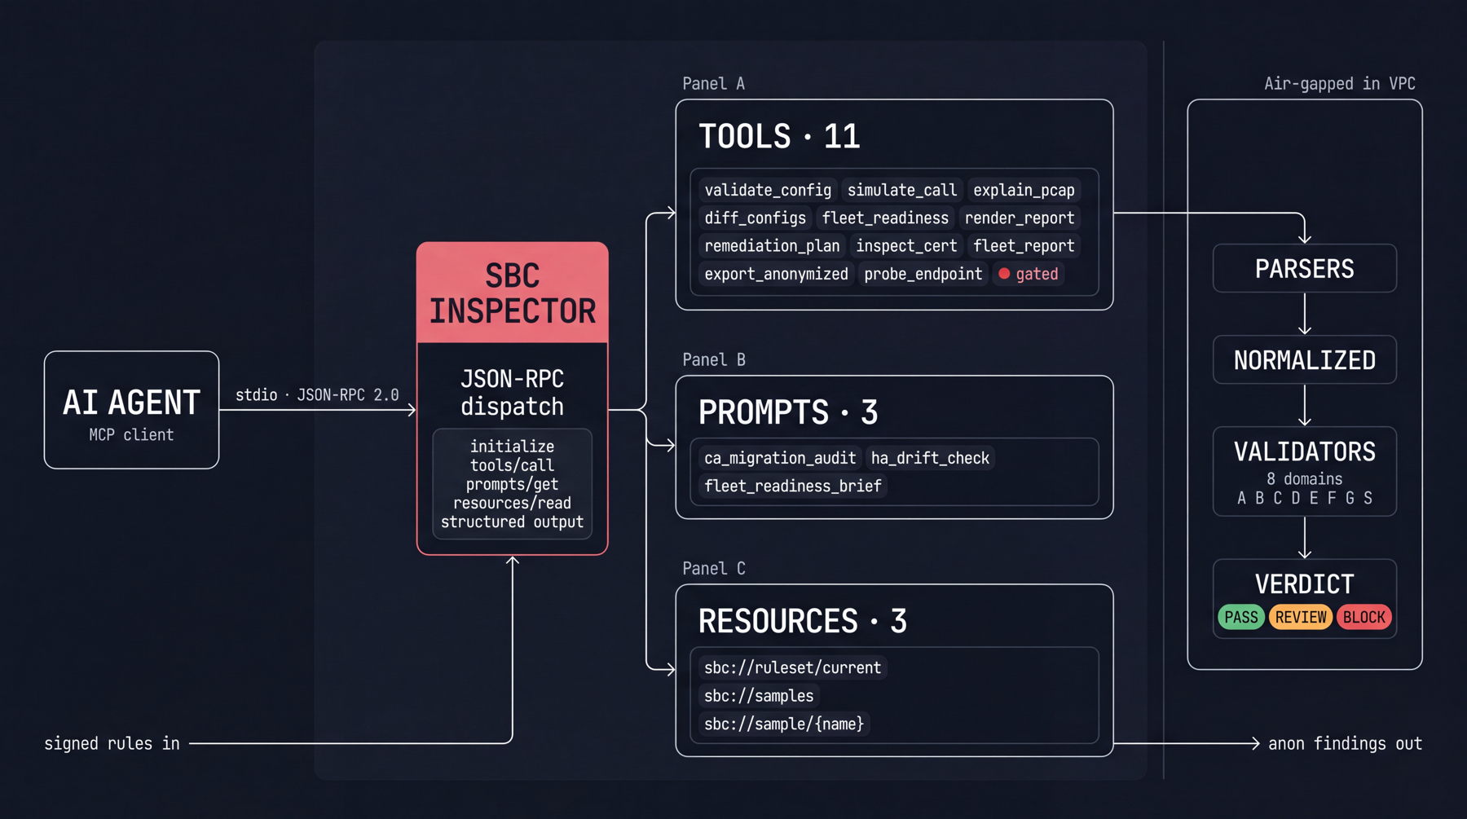

Slide 15

Everything else is single-vendor, or watches the call after it fails
Approach | What it does | Against the 2026 problem
Post-deployment AIOps | Inspects active SIP and RTP: jitter, latency, MOS | Blind. The failure drops TLS before signaling exists.
Vendor tools (OVOC, RAMP, EM) | Manage their own hardware only | Siloed. Real estates are multi-vendor; no single pane exists.
Ribbon LEAP (closest comparable) | AI that learns live call flows, generates test scripts | Ribbon-only. Our pitch: LEAP, but cross-vendor.
SBC-AutoOps | Validates any vendor's config before deploy, then predicts the call | Catches the missing root, the wrong EKU, the SRTP gap. From the config, before traffic, across the whole fleet.
Structural argument: a vendor is biased to its own hardware and cannot credibly build the layer that reads everyone's.

Slide 16
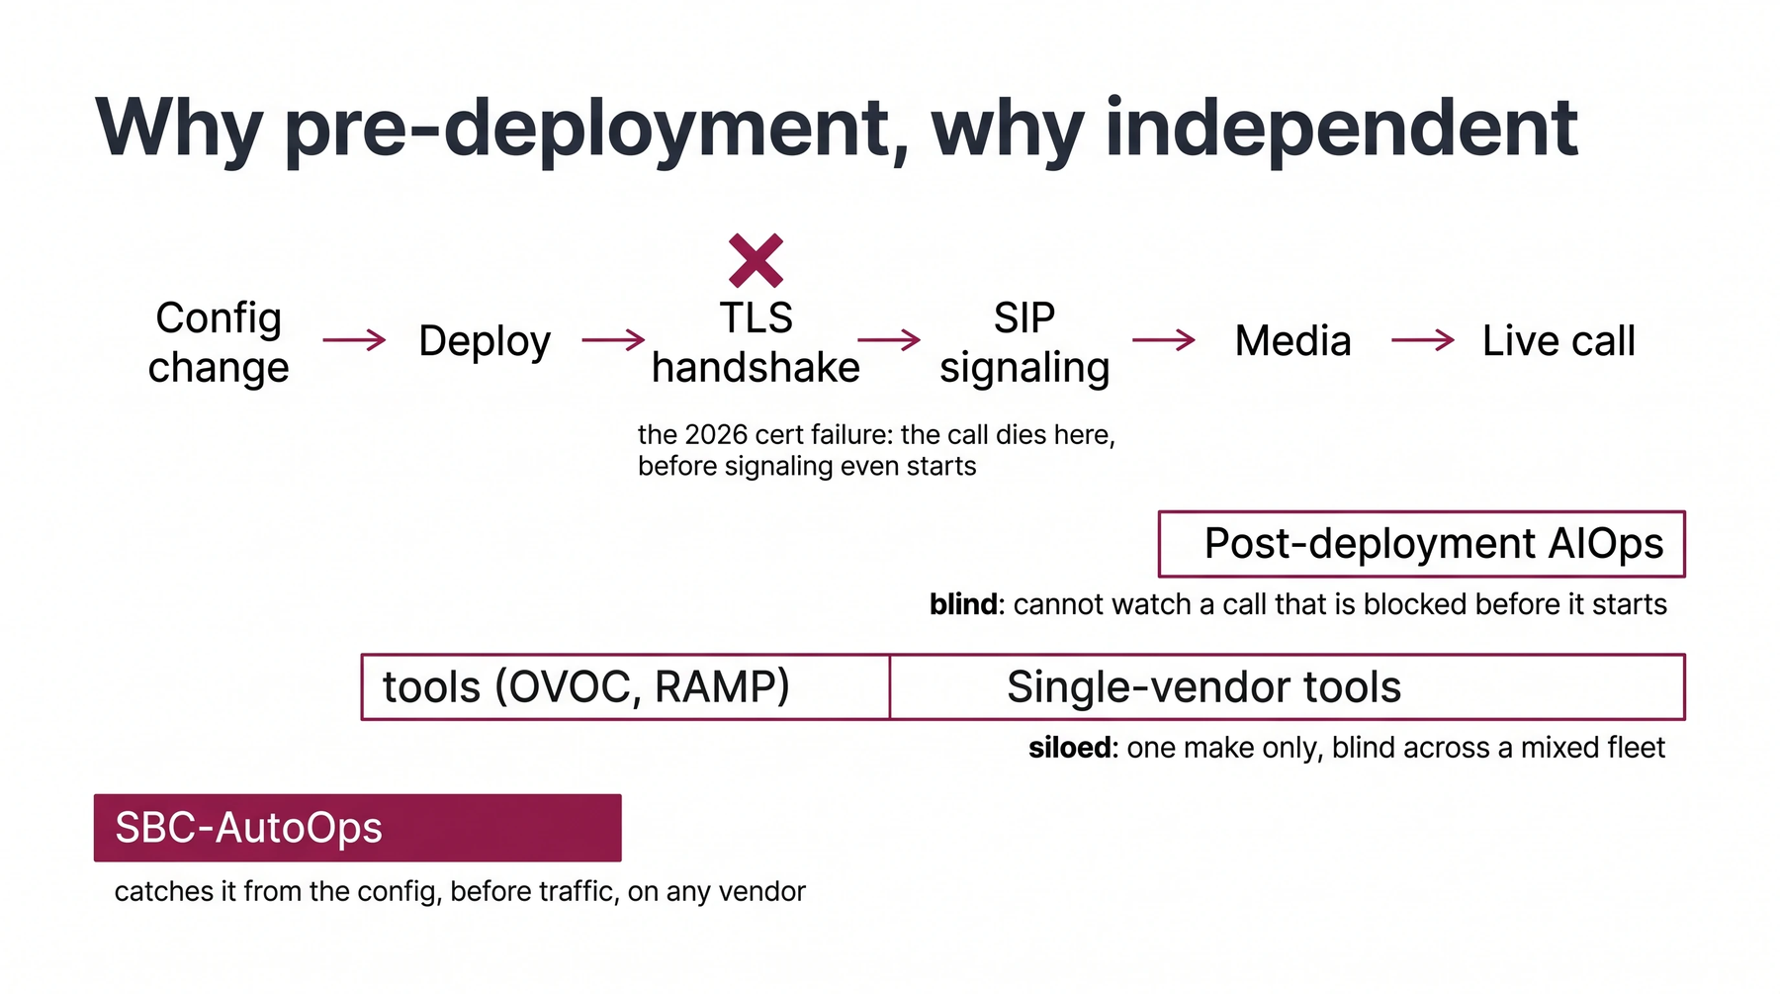

Slide 17


Verify, don't trust
The meeting we want with you is your security review. Every claim below is checkable in the source.
Build from source
Signed everything
SHA-256 integrity manifest, CycloneDX SBOM, pip-audit in CI on every push. Nothing pre-built to trust.
Releases cosign-signed (keyless Sigstore). Rule bundles Ed25519-signed, verified against a source-pinned key.
One dependency
Deterministic
The cryptography library, guarded by a ratchet test. pcap reader, rule client, and dashboard are stdlib.
Same config plus same ruleset always equals the same verdict. No model temperature in the verdict path.
Runs your way
Disclosed before asked
Docker is packaging, not a requirement: pip install on Python 3.10+, offline wheels, rootless Podman.
An early dev-only signing key was rotated June 7 and scrubbed from history. We tell you because the posture must survive your diff audit.

Slide 18
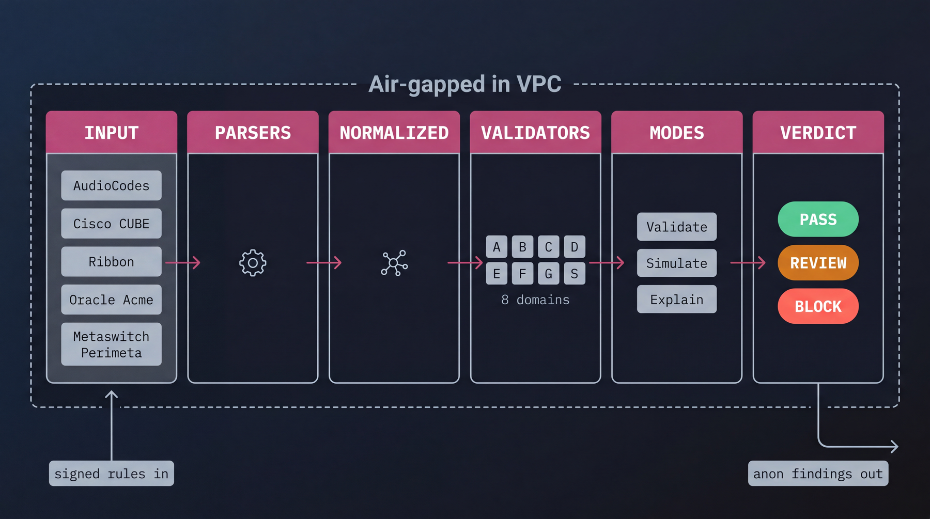

Slide 19

The design partnership
Two partners, 50 or more SBCs, mixed-vendor estate. The trade is one sentence: one sanitized config per vendor you run, for a 2026 readiness audit across your whole fleet, air-gapped in your environment.
What you get
What we ask, and how it runs
The full-fleet readiness audit, run by your team, on your hosts; reports stay on your disk
Depth built against your platforms first: each config converts gated domains to firing, your fleet view first
A deterministic pre-deploy gate for your CI and change process, with version-stamped evidence your auditors can cite
Both founders, direct, through the pilot; first input on the roadmap
One real, sanitized config per vendor. A per-vendor checklist defines exactly what to export and strip; your security team approves it
Mutual NDA first, then the checklist, then the pilot, air-gapped
Candid feedback on verdicts against your ground truth
Honest answer to the obvious question: you would be in the first cohort. That is the deal, stated plainly

Slide 20
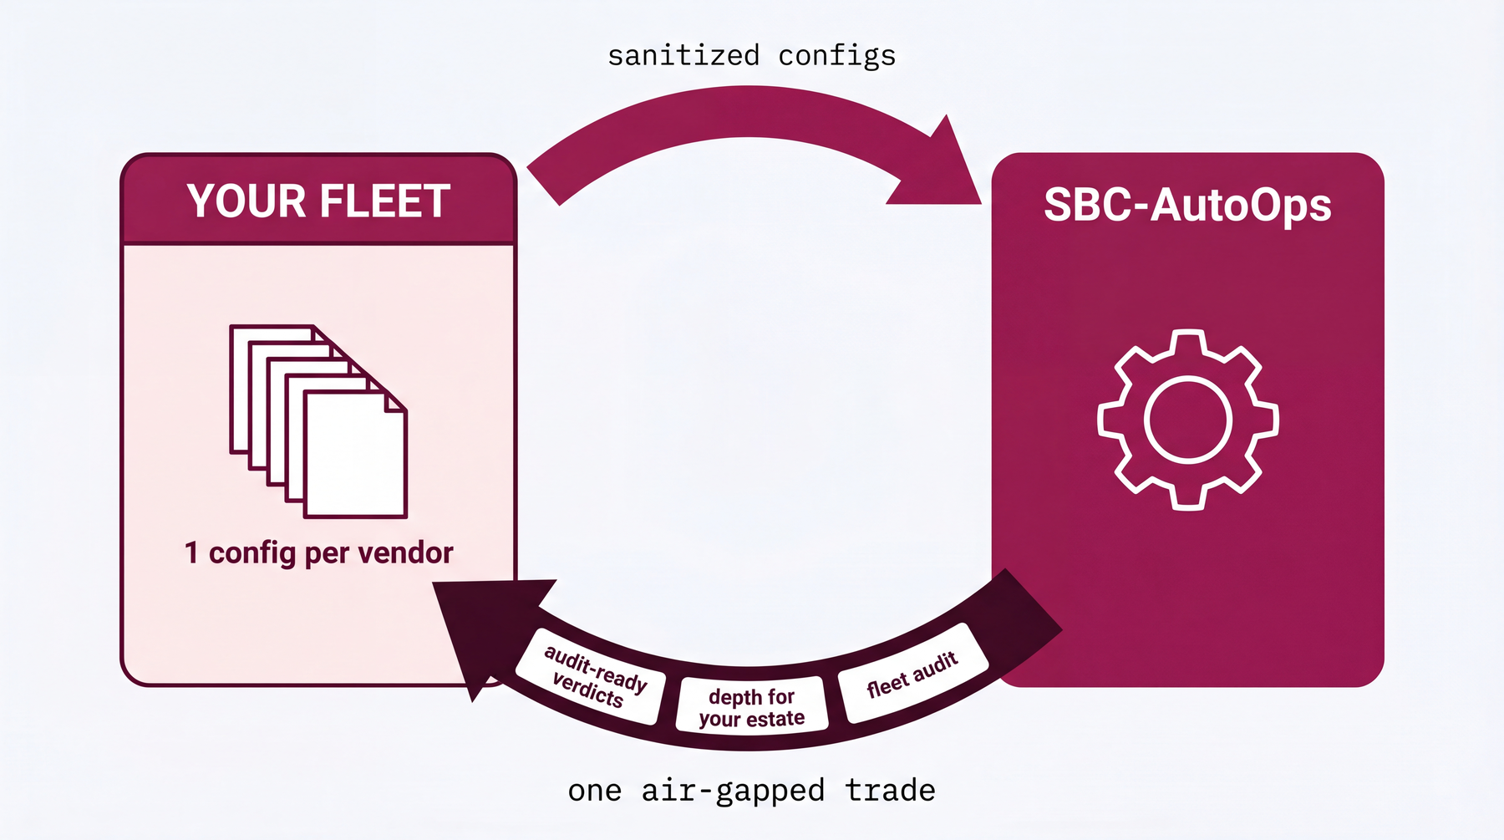

Slide 21
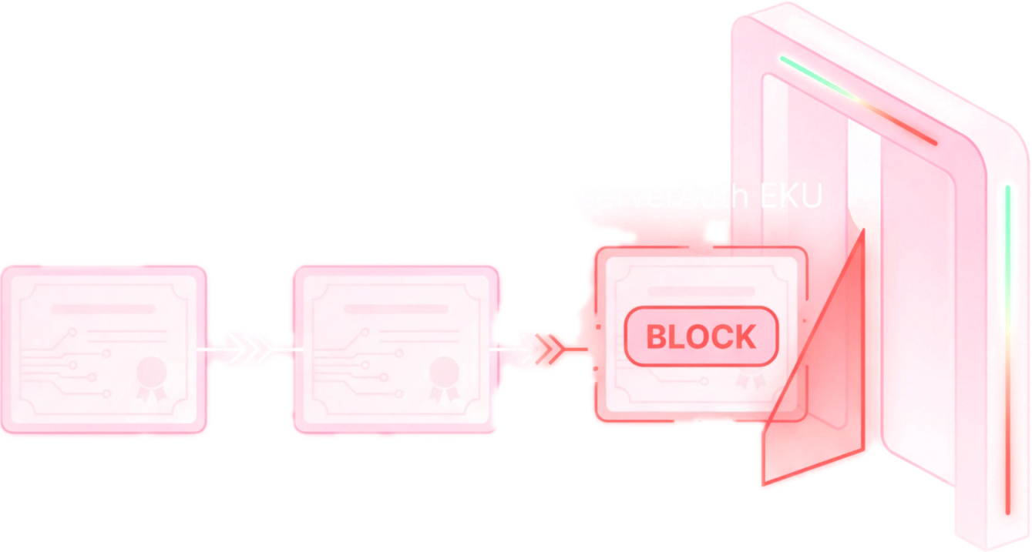
The next step is your security review.
A 30-minute working session: we walk the data-flow contract first, run the live demo second, and leave you the source to verify. If the review holds, the pilot starts with an NDA and a sanitization checklist, not a contract.
Pre-read sbcvalidator.metaventionsai.com/#security
Free edge check sbcvalidator.metaventionsai.com/scanner
Contact dicoangelo@metaventionsai.com
METAVENTIONS AI · Dico Angelo and Philip Drammeh

Slide 22
